Slide 1

What is a Command Bus?
Brian Korzynski

Slide 2
About Me
Sr. Machine Learning Engineer
Professional Developer for 10+ years
Windows Forms
Web
Mobile
SQL Optimization
Data Analysis
Mathematics
Big Data
Cloud
Machine Learning

Slide 3
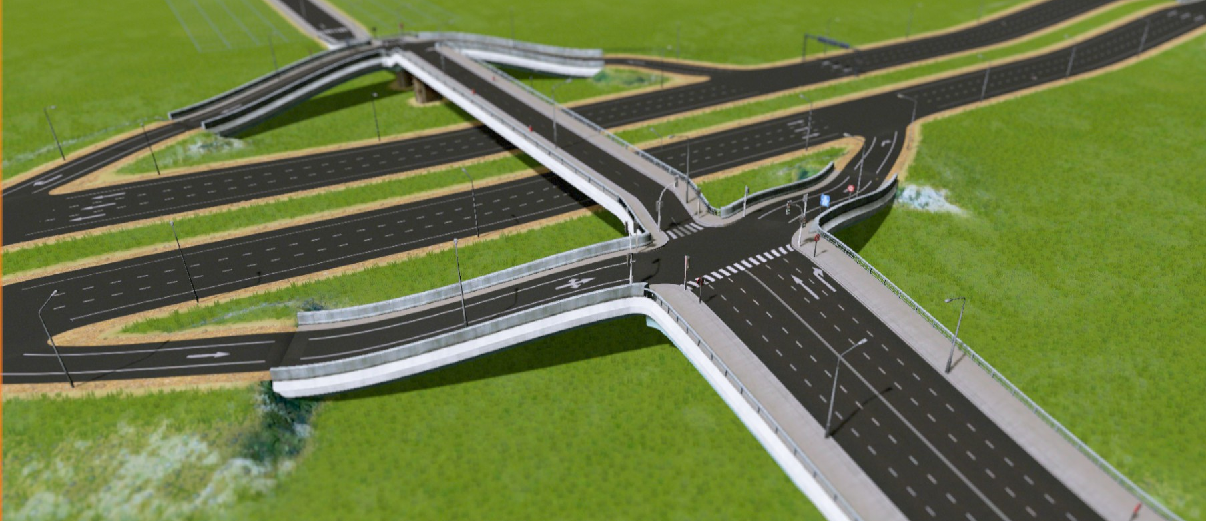
What is a bus?
Notes:
https://steamcommunity.com/sharedfiles/filedetails/?id=522776740

Slide 4
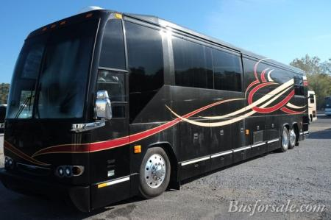
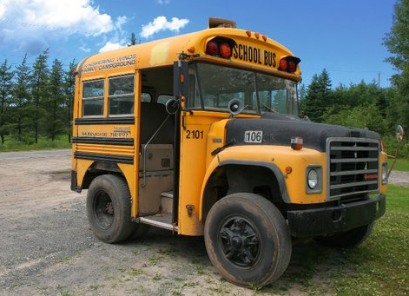
Kinds of Busses
Notes:
tour bus
https://www.google.com/imgres?imgurl=https%3A%2F%2Fwww.busforsale.com%2Fbuses%2Fphotos%2Fmarlin%2Fthumb%2Fthumb_marlinext4.jpg&imgrefurl=https%3A%2F%2Fwww.busforsale.com%2Fbuses%2F&docid=NIU8_flpBWz1fM&tbnid=C0kZ2itbgFS4nM%3A&vet=10ahUKEwjwovmY8ePfAhWGk1kKHTIqAooQMwhoKAEwAQ..i&w=450&h=299&bih=843&biw=1440&q=tour%20bus&ved=0ahUKEwjwovmY8ePfAhWGk1kKHTIqAooQMwhoKAEwAQ&iact=mrc&uact=8
short bus
https://www.reddit.com/r/funny/comments/hvtgu/the_short_bus/

Slide 5
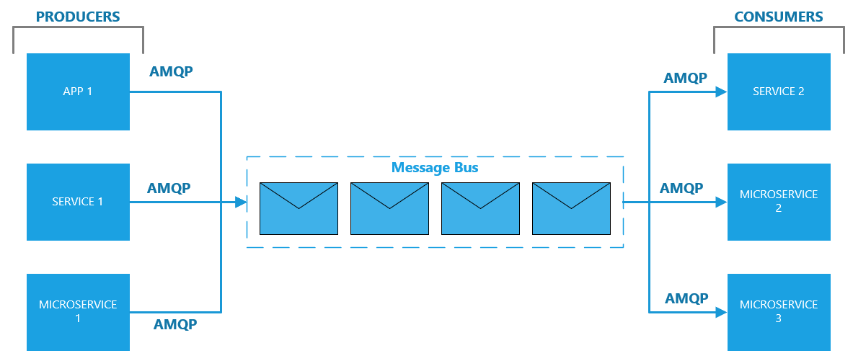
Kinds of Busses: The Message Bus

Slide 6
Message Bus Platforms
Microsoft Azure Service Bus
Rabbit MQ /CloudAMQP (hosted Rabbit MQ)
Amazon Simple Queuing Service (SQS)

Slide 7
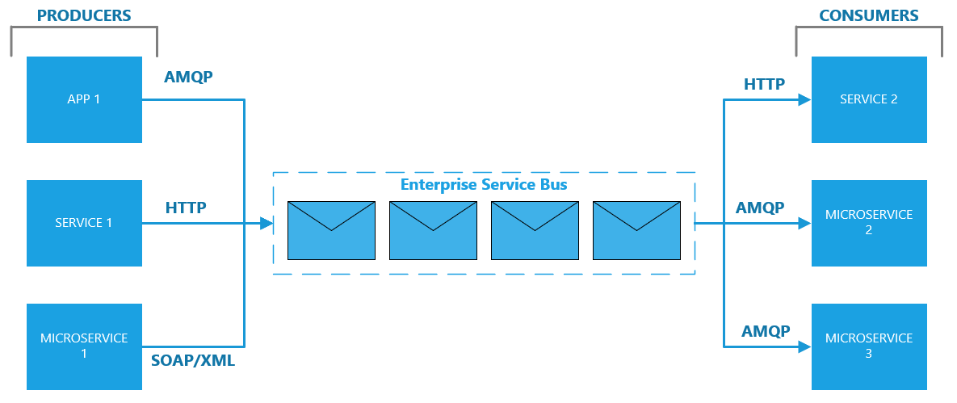
Kinds of Busses: The Enterprise Service Bus (ESB)

Slide 8
Enterprise Service Bus Platforms
MuleSoft
Neuron ESB
NServiceBus

Slide 9
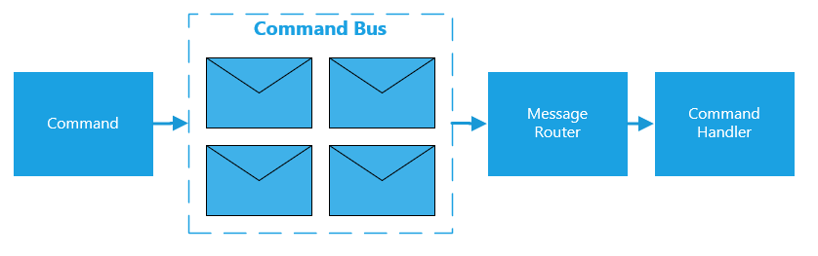
Kinds of Busses: The Command Bus

Slide 10
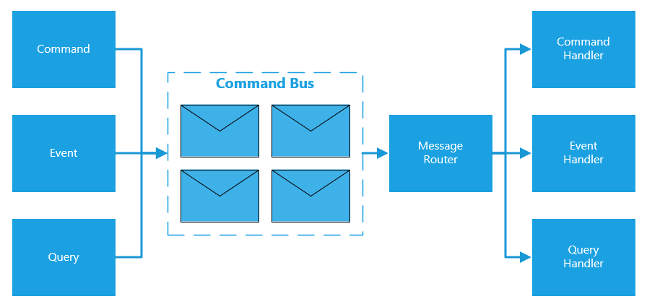
Kinds of Busses: The Typical Command Bus

Slide 11
DEMO

Slide 12
Pattern: Command
An operation that effects some change to the system (for example, setting a variable). An operation that intentionally creates a side effect. – DDD book
In object-oriented programming, the command pattern is a behavioral design pattern in which an object is used to encapsulate all information needed to perform an action or trigger an event at a later time. This information includes the method name, the object that owns the method and values for the method parameters. – Wikipedia

Slide 13
Pattern: Command-Query Separation
Command–query separation (CQS) is a principle of imperative computer programming. It was devised by Bertrand Meyer as part of his pioneering work on the Eiffel programming language.
It states that every method should either be a command that performs an action, or a query that returns data to the caller, but not both. In other words, Asking a question should not change the answer.[1] More formally, methods should return a value only if they are referentially transparent and hence possess no side effects. -Wikipedia

Slide 14

Pattern: Command Query Responsibility Segregation

Slide 15
DEMO

Slide 16
Frameworks
MediatR
EventFlow

Slide 17
MediatR
Out-of-the-box does everything that we created manually (only better)
Async by default (you can force synchronous, but it is anti-pattern)

Slide 18
DEMO

Slide 19
MediatR
Supports more patterns than just commands and queries such as:
Request/Response
Notifications
Events
Synchronous and Asynchronous dispatching
Supports all common DI/IoC packages
Autofac
Ninject
StructureMap
Castle Windsor
Unity
.Net Core (using the MediatR.Extensions.Microsoft.DependencyInjection NuGet)
Dryloc
Lamar

Slide 20
MediatR
Treats mediation like a pipeline in which you can override the default behavior at every step.
Supports pre-processing before handlers are called
Input Validation
Authorization (e.g. make sure the current user has permissions to perform the action)
Log request
Supports post-processing after handlers are called
Exception Handling & Logging
Pipeline Examples for logging, validation, and authorization https://lostechies.com/jimmybogard/2016/10/13/mediatr-pipeline-examples/

Slide 21
MediatR – Expansion Packages
MediatR.Extensions.FluentValidation for validating requests
MediatR.EventAggregator – event aggregation

Slide 22
Pro Tips
Make sure you still follow the single responsibility principle
Handlers are not God classes
Handlers are typically a one to one with a command
If you have some long running processes, then you might want to use something like DataFlows (TPL) to queue things up
Develop and follow your own naming conventions e.g. actionObjectCommand e.g. InactivateCustomerCommand
I would advise adding a reference to the command bus inside your handlers when you need it

Slide 23
Questions
github.com/korz
@bkorzynski

